Slide 1

Airbnb BA Presentation

Slide 2


Average Listing Price Per Market
Average listing price per market info..
City | Average Listing Price | Rank

Slide 3

Property Types Per City
Taipei
Property type per city …
City | Property Type | Listing Count | Percent Total Per City

Slide 4

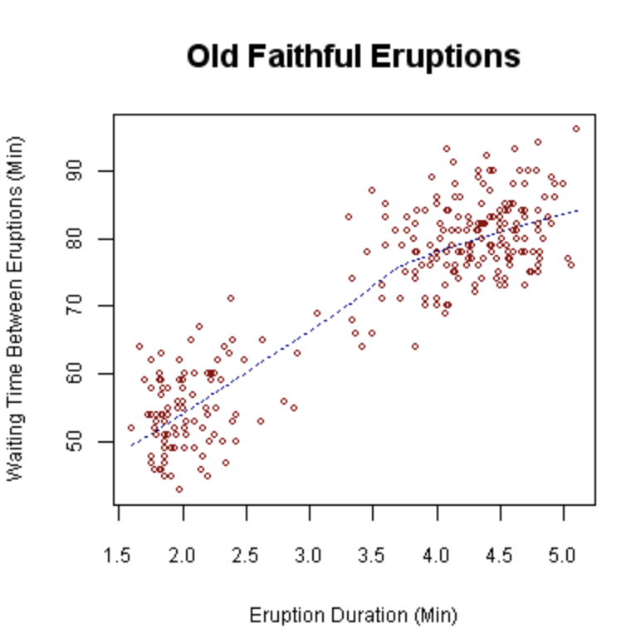
Correlation Analysis
The correlation shows a strong positive correlation between x and y…

Slide 5

Modeling
Modeling info…
City | Average Yearly Profit | Listings > Avg. Profit | Percent Above Market

